Slide 1
Max Nav
Domestic/Indoor Navigation System.

Slide 2
Team Members
Sharwin Xavier
Elizabeth Subhiksha Victoria
Veroni Shwetha
Sandesh A
Praveen Rijal
Fabian Ferno
STARKILLERS

Slide 3
Max Nav
Organisation:
Problem Statement:
Problem Statement ID:
Team Name:
Team Leader:
College Code:
DTE of IT & Cyber Security
Indoor Navigation App
CK139
Starkillers
Fabian Ferno
3111

Slide 4
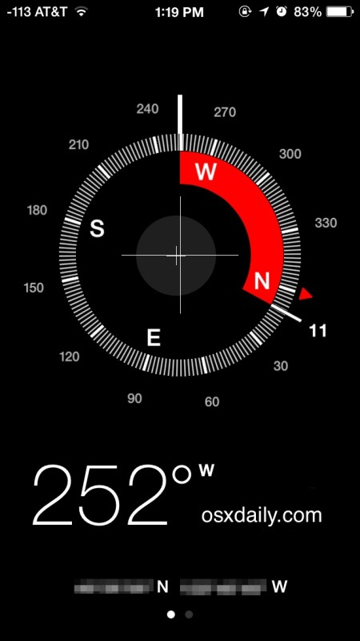
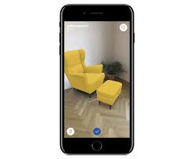
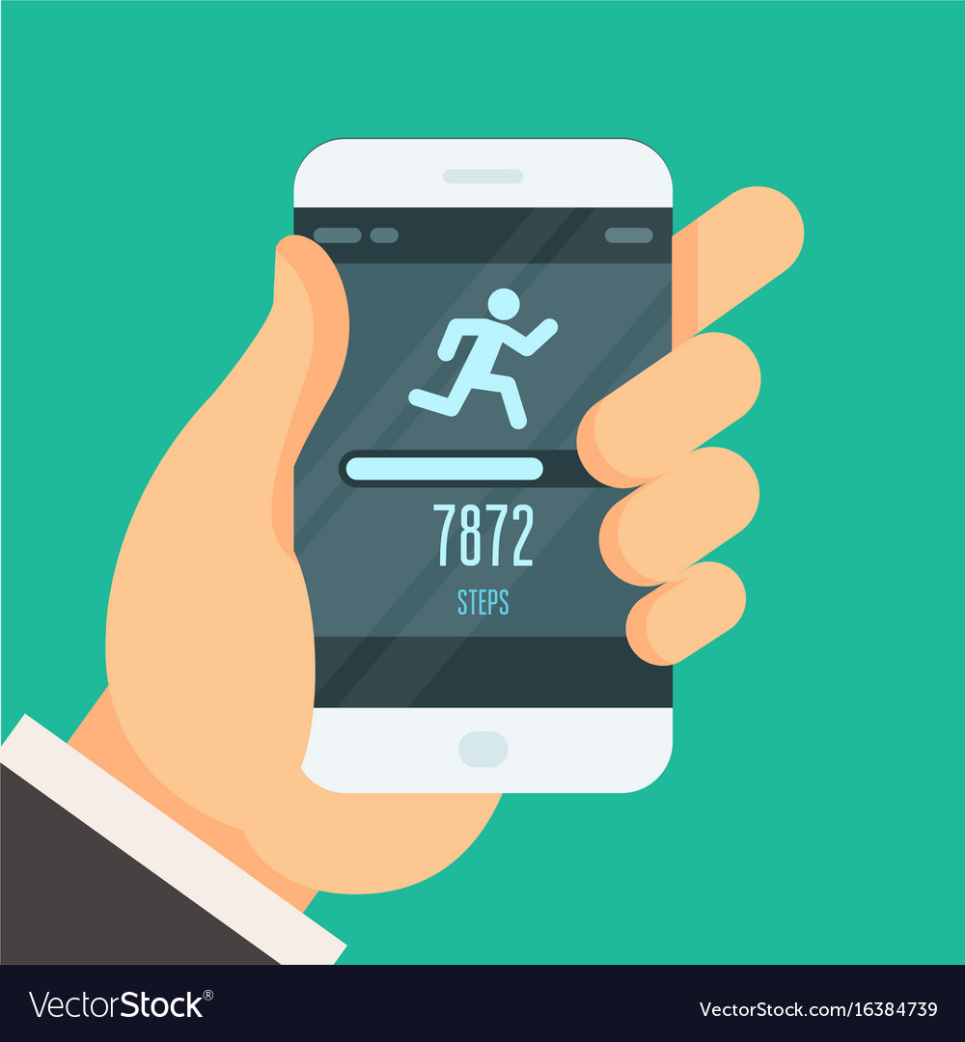

OUR IDEA

Slide 5
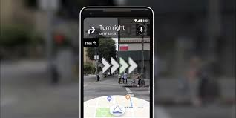
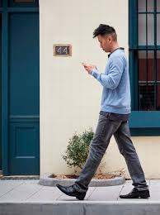

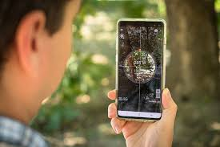
HOW MAX NAV WORKS?
MAX NAV INITIALLY ALLOWS THE USER TO REGISTER HIS LOCATION THROUGH BUILDING PLANS OR BY RECORDING HIS PATH USING THE APP AND LATER IT CAN BE USED TO NAVIGATE THROUGH BUILDINGS BY JUST TYPING THE BUILDING CODE.
AUGMENTED REALITY IS ALSO USED IN COMPATIBLE DEVICES TO GUIDE THE PERSON THROUGH THE CAMERA.

Slide 6

HOW WE PLAN BUILDING REGISTRATION?
1. We use Pedometer to track the steps of the user and magnetic compass to to find their direction.
2. Every data is recorded first and registered in the app.
3. Each location can be named by the user during registration. (ex: hall, reception, restrooms, auditorium ,.etc )
4. Staircases and Turns in the building are easily marked with the appropriate tools during registration.

Slide 7
5 .After registering the user will be saved along with the navigation he provided under a randomly generated buildcode.
6 .The user can also take pics of random spots like rooms for easy identification.
7 .Later the code will be used for navigation by public who use this app.
8 .Similarly data from multiple users are taken and the code is combined with the location for more accurate Navigation.

Slide 8

HOW TO NAVIGATE?
After registration, the app will use the AR for compatible devices and animation for others to show the direction .
Any location in that building can be searched and by relevancy app guides the peole to the desired location .
When the person navigates the Augmented reality or animation will give guidelines to the location.
The person will be shown how many steps have been recorded by the user and also the shortest route will be preferred first.when the person gets closer to the location the person will be viewed a pic of how the entrance will be like and maybe a panoramic view of the place.

Slide 9
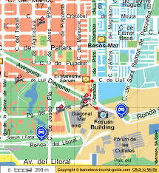
ADVANTAGES
MAX NAV
1.This app never uses GPS or Bluetooth transmitters and so it is cost effective.
2.The app can be used on all android devices.
3.The app can be devised in such a way that it can also be helpu to find a person who is in emergency and also for woman safety.
4.Thus there wont be any need for building guide maps anymore.

Slide 10
DISADVANTAGES
*The app can only give relative data but not accurate data.
Solution: Indoor navigation might not need accuracy because there might not be a hindrance in finding indoor locations with relative data.
*Mostly AR is not compatible in Indian low budget mobiles .
Solution: the app has animation instead of AR to support incompatible devices.
*The user might find it difficult to register in the beginning but will find it useful at the end.

Slide 11
PROBLEM
A Lot of navigation apps like Google Maps are available for navigation but none of them support navigation inside a building by taking into account rooms, corridors and floors. The challenge is to create an app that would show a navigation path in the real world on your mobile device screen. This technology is beneficial to everyday citizens because it allows one to accurately navigate to a specific location in a building they have never been to before, such as government offices, a classroom in a campus, malls/retail stores to show customers the items they would want to purchase etc.

Slide 12
SOLUTION
The additional acquisitions of a geospatial data visualization building, measurements of objects and its ability to find the shortest route to a place including the timings and the no. of steps we have walked make this project unique.The UI shows a map and a 3D view of the specified location inside the building offering better and accurate features with utilization of AI. It also provides a small description of the place which automatically pops on the screen on the app as we walk. This will help the user helping them to navigate what, when and where they need to go and thereby improving the curiosity of the user.The concept can be implemented and applied in various fields within a short period of time. It can also be used in forests or war zones to exactly locate a place or a path which was lost. The location can be retracted using this app, since it creates its own custom map rather than downloading the standard maps...

Slide 13






SOLUTION
Augmented Reality. A Technology that’s not being used in its full potential. We incorporated AR Technology in our application to give immersive guidances through the phone’s camera. The layout of the building is constructed automatically by parameters and sensors such as Pedometer(step counter) and Gyroscope(compass), etc. After the complete generation of the layout, the digital blueprint is fed to the AR module which gives guidance to the user using the camera.
TECHNOLOGY STACK
Front End
XML
Android Studio
AR Core
Sketchup 3D
Platform
Android
Windows 10
Back End
Java

Slide 14

Technology Stack
Front End
XML
Android Studio
AR Core
Sketchup 3D
Back End
Java
Platform
Android
Windows 10

Slide 15
Use Cases
Highly user friendly Augmented Reality technology makes it easier to navigate through any environment. The app spontaneously updates after reaching the desired location. It can be implemented in metro stations, subways and high storey buildings also transmits alert signals in case of emergency. People who find themselves lost should be able to find the location at a subway or metro park. And in case of emergency if they are in trouble, they can press the alert button sequence which automatically sends her location to the nearby security personnel through the mobile thereby enabling them to track them.

Slide 16
Working
Implementing foot steps tracking integrated with a directional compass.
Using Bluetooth transmitters in the building premises. The signal strength intensity mapping adds another input factor to the overall building data.
Creating a virtual map using the fragments of data.
Providing Augmented Reality based visual guidance for internal/domestic navigation.

Slide 17
Dependencies
Practically not entirely accurate results.
Involves rapid drain in battery due to over use of sensors and camera.
The AI navigation might be difficult for certain scenarios.

Slide 18
THANK YOU

